Slide 1

Chapter 4
The Relational Model

Slide 2
Objectives
Terminology of relational model.
How tables are used to represent data.
Connection between mathematical relations and relations in the relational model.
Properties of database relations.
How to identify CK, PK, and FKs.
Meaning of entity integrity and referential integrity.
Purpose and advantages of views.

Slide 3
Relational Model Terminology
A relation is a table with columns and rows.
Only applies to logical structure of the database, not the physical structure.
Attribute is a named column of a relation.
Domain is the set of allowable values for one or more attributes.

Slide 4
Relational Model Terminology
Tuple is a row of a relation.
Degree is the number of attributes in a relation.
Cardinality is the number of tuples in a relation.
Relational Database is a collection of normalized relations with distinct relation names.

Slide 5
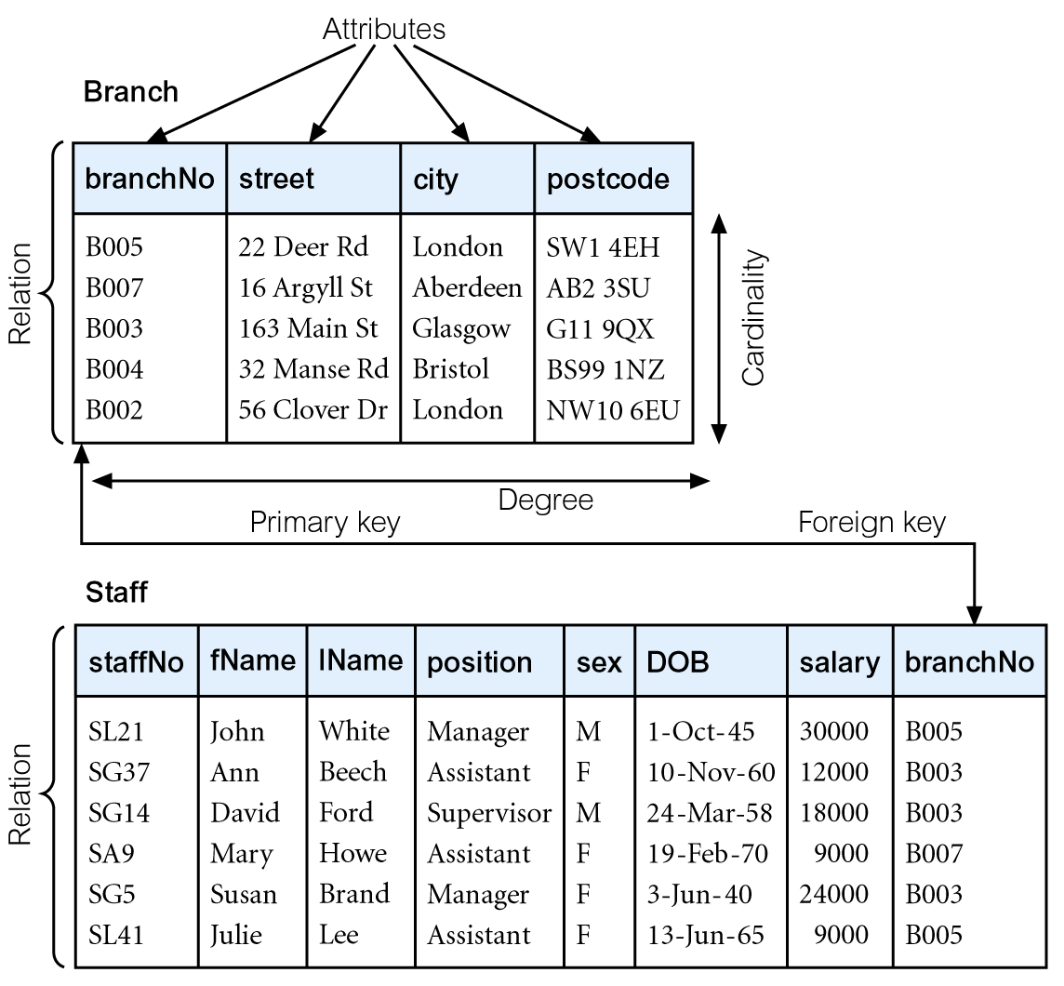
Instances of Branch and Staff Relations

Slide 6
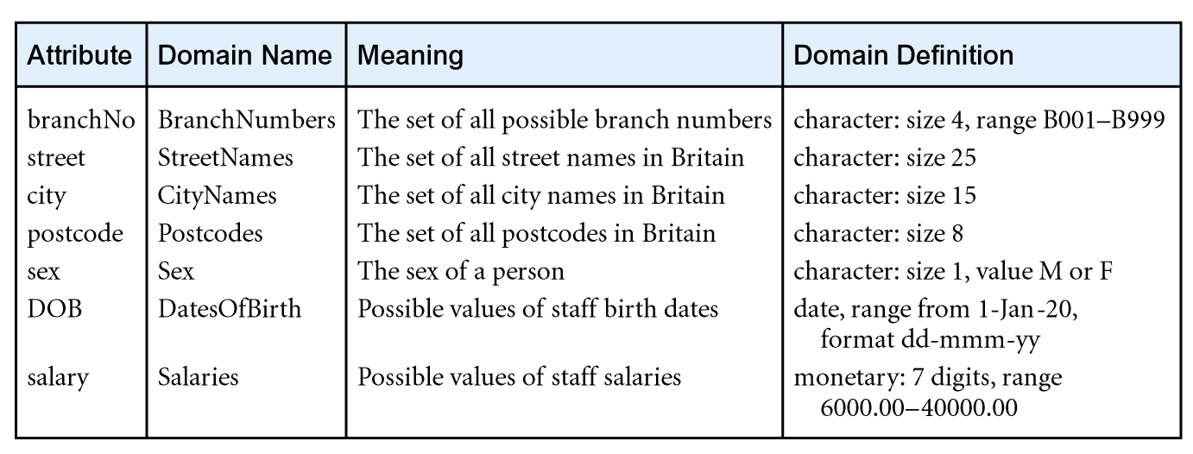
Examples of Attribute Domains

Slide 7
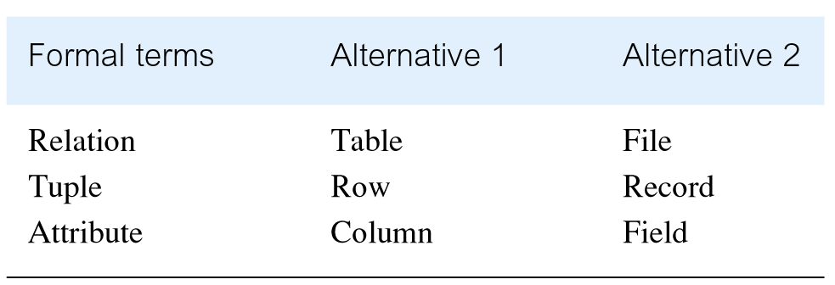
Alternative Terminology for Relational Model

Slide 8
Mathematical Definition of Relation
Consider two sets, D₁ & D₂, where D₁ = {2, 4} and D₂ = {1, 3, 5}.
Cartesian product, D₁ × D₂, is set of all ordered pairs, where first element is member of D₁ and second element is member of D₂.
D₁ × D₂ = {(2, 1), (2, 3), (2, 5), (4, 1), (4, 3), (4, 5)}
Alternative way is to find all combinations of elements with first from D₁ and second from D₂.

Slide 9
Mathematical Definition of Relation
Any subset of Cartesian product is a relation; e.g.
R = {(2, 1), (4, 1)}
May specify which pairs are in relation using some condition for selection; e.g.
second element is 1:
R = {(x, y) | x ∈D₁, y ∈D₂, and y = 1}
first element is always twice the second:
S = {(x, y) | x ∈D₁, y ∈D₂, and x = 2y}

Slide 10
Mathematical Definition of Relation
Consider three sets D₁, D₂, D₃ with Cartesian Product D₁ × D₂ × D₃; e.g.
D₁ = {1, 3} D₂ = {2, 4} D₃ = {5, 6}
D₁ × D₂ × D₃ = {(1,2,5), (1,2,6), (1,4,5), (1,4,6), (3,2,5), (3,2,6), (3,4,5), (3,4,6)}
Any subset of these ordered triples is a relation.

Slide 11
Mathematical Definition of Relation
Cartesian product of n sets (D₁, D₂, . . ., D_{n}) is:
D₁ × D₂ × . . . × D_{n} = {(d₁, d₂, . . . , d_{n}) | d₁ ∈D₁, d₂ ∈D₂, . . . , d_{n}∈D_{n}}
usually written as:
n
XD_{i}
^{i = 1}
Any set of n-tuples from this Cartesian product is a relation on the n sets.

Slide 12
Database Relations
Relation schema
Named relation defined by a set of attribute and domain name pairs.
Relational database schema
Set of relation schemas, each with a distinct name.

Slide 13
Properties of Relations
Relation name is distinct from all other relation names in relational schema.
Each cell of relation contains exactly one atomic (single) value.
Each attribute has a distinct name.
Values of an attribute are all from the same domain.

Slide 14
Properties of Relations
Each tuple is distinct; there are no duplicate tuples.
Order of attributes has no significance.
Order of tuples has no significance, theoretically.

Slide 15
Relational Keys
Superkey
An attribute, or set of attributes, that uniquely identifies a tuple within a relation.
Candidate Key
Superkey (K) such that no proper subset is a superkey within the relation.
In each tuple of R, values of K uniquely identify that tuple (uniqueness).
No proper subset of K has the uniqueness property (irreducibility).

Slide 16
Relational Keys
Primary Key
Candidate key selected to identify tuples uniquely within relation.
Alternate Keys
Candidate keys that are not selected to be primary key.
Foreign Key
Attribute, or set of attributes, within one relation that matches candidate key of some (possibly same) relation.

Slide 17
Integrity Constraints
Null
Represents value for an attribute that is currently unknown or not applicable for tuple.
Deals with incomplete or exceptional data.
Represents the absence of a value and is not the same as zero or spaces, which are values.
Note: The database structural query language SQL implements ternary logic as a means of handling NULL. Three-valued logic (true, false, NULL)

Slide 18
Integrity Constraints
Entity Integrity
In a base relation, no attribute of a primary key can be null.
Referential Integrity
If foreign key exists in a relation, either foreign key value must match a candidate key value of some tuple in its home relation or foreign key value must be wholly null.

Slide 19
Integrity Constraints
General Constraints
Additional rules specified by users or database administrators that define or constrain some aspect of the enterprise.

Slide 20
Views
Base Relation
Named relation corresponding to an entity in conceptual schema, whose tuples are physically stored in database.
View
Dynamic result of one or more relational operations operating on base relations to produce another relation.

Slide 21
Views
A virtual relation that does not necessarily actually exist in the database but is produced upon request, at time of request.
Contents of a view are defined as a query on one or more base relations.
Views are dynamic, meaning that changes made to base relations that affect view attributes are immediately reflected in the view.

Slide 22
Purpose of Views
Provides powerful and flexible security mechanism by hiding parts of database from certain users.
Permits users to access data in a customized way, so that same data can be seen by different users in different ways, at same time.
Can simplify complex operations on base relations.

Slide 23
Updating Views
All updates to a base relation should be immediately reflected in all views that reference that base relation.
If view is updated, underlying base relation should reflect change.

Slide 24
Updating Views
There are restrictions on types of modifications that can be made through views:
Updates are allowed if query involves a single base relation and contains a candidate key of base relation.
Updates are not allowed involving multiple base relations.
Updates are not allowed involving aggregation or grouping operations.

Slide 25
Updating Views
Classes of views are defined as:
theoretically not updateable;
theoretically updateable;
partially updateable.

Slide 26
Conceptual model ➔ Logical model
Transforming a conceptual model (ERD) into a logical model (e.g., relational).

Slide 27
Conceptual model (ERD)

Slide 28
Logical Model (Relational Model)
Relational Schema
Product (
Order (
OrderLine (
Price (

Slide 29
Mapping of Entity-Relationship Model into Relational Database Design
Entities Each entity is mapped into a relation (table).
Relationships
1:1 Binary Relationship
The primary key of one relation is placed in the other relation (as a foreign key)
1:M Binary Relationship
The primary key of one parent relation (side 1) is placed in the child relation (as a foreign key) (side M).
M:M Binary Relationship
Create an associative entity. Corresponding relation includes primary keys from both relations.
Recursive (Unary) Relationships
1:1, 1:M, M:M are mapped the same way as binary relationships

Slide 30
CDM → Relational Model (Logical)
IS-A (Supertype/Subtype) Relationship
Relational DBMS has no direct methods of representing inheritance. The supertype and subtype entities must be represented as relations.
Three methods (Supertype only, Subtype only, Both):
Create one relation that includes a sum of all attributes (supertype and subtypes)
Create relation for each subtype and include all inherited attributes in each subtype
Create a relation for supertype and for each subtype and add an identifying attribute to superclass relation
Ternary Relationship
Ternary relationship is mapped into a relation with three foreign keys.

Slide 31
Example: (Assignment 2)
The purpose of this form shown below is to record the medication given to a particular patient at the Wellmeadows Hospital. Examine the data shown on the form. Discuss how the data shown on this form could be represented in tables.

